Slide 1
Meeting a Younger Audience
Aleksandra Piatek - Development Studies MA
Dia Aziz - Marketing and Management BSc
Joshua Jones - Business and Management Studies BSc
Joshua Croudace - Business and Management Studies BSc
Yori Afolabi - Economics BSc

Slide 2
Executive Summary
Lewes District Citizens Advice (LDCA) have struggled to engage people aged 16-25 in the local area
Following the market review, young people need advice regarding
Housing
Financial issues
Mental health
and many other aspects
To address these, we recommend that LDCA introduce a youth engagement scheme
Social media presence
Trust
Engagement
Confidence
Boost youth employment opportunities through experience on their CVs

Slide 3
Situation & Challenge
LDCA asked the Sussex student consultancy team to help research the advice needs and behaviour of young people in the Lewes district due to a lack of engagement amongst 16-25 year olds, even though evidence suggests that this age bracket would greatly benefit from receiving impartial advice from citizens advice services.

Slide 4
Approach
Researched the key areas affecting young people in the East Sussex and Lewes districts
Examined 2021 census data to determine the age and income demographic
Explored local options that young people have for advice as well as other organisations that LDCA can collaborate with
Analysed trusted platforms available to young people in the area - focus on social media
Established recommendations for engaging 16-25 year olds

Slide 5
Top Advice for Young People
(Citizens Advice resources)
Rights of young people on family matters
Young people’s rights in general
Proof of age
Discrimination
Personal records
Punishment
Religion
Checking your rights at work if you’re under 18
Renting with others, problems with shared housing and how to complain
https://www.citizensadvice.org.uk/resources-and-tools/search-navigation-tools/Search/?q=young+people&c=TOP-PUBLIC

Slide 6
University of Sussex and Citizen’s Advice
The University does provide access to citizen’s advice
Many students may not be aware of this, so learning from Sussex university, if you were going to collaborate with schools, colleges, and/or universities, we would recommend:
Sending out emails, fliers and putting up posters
Running workshops or information sessions
Establishing a presence -> increasing awareness -> building trust and engagement

Slide 7
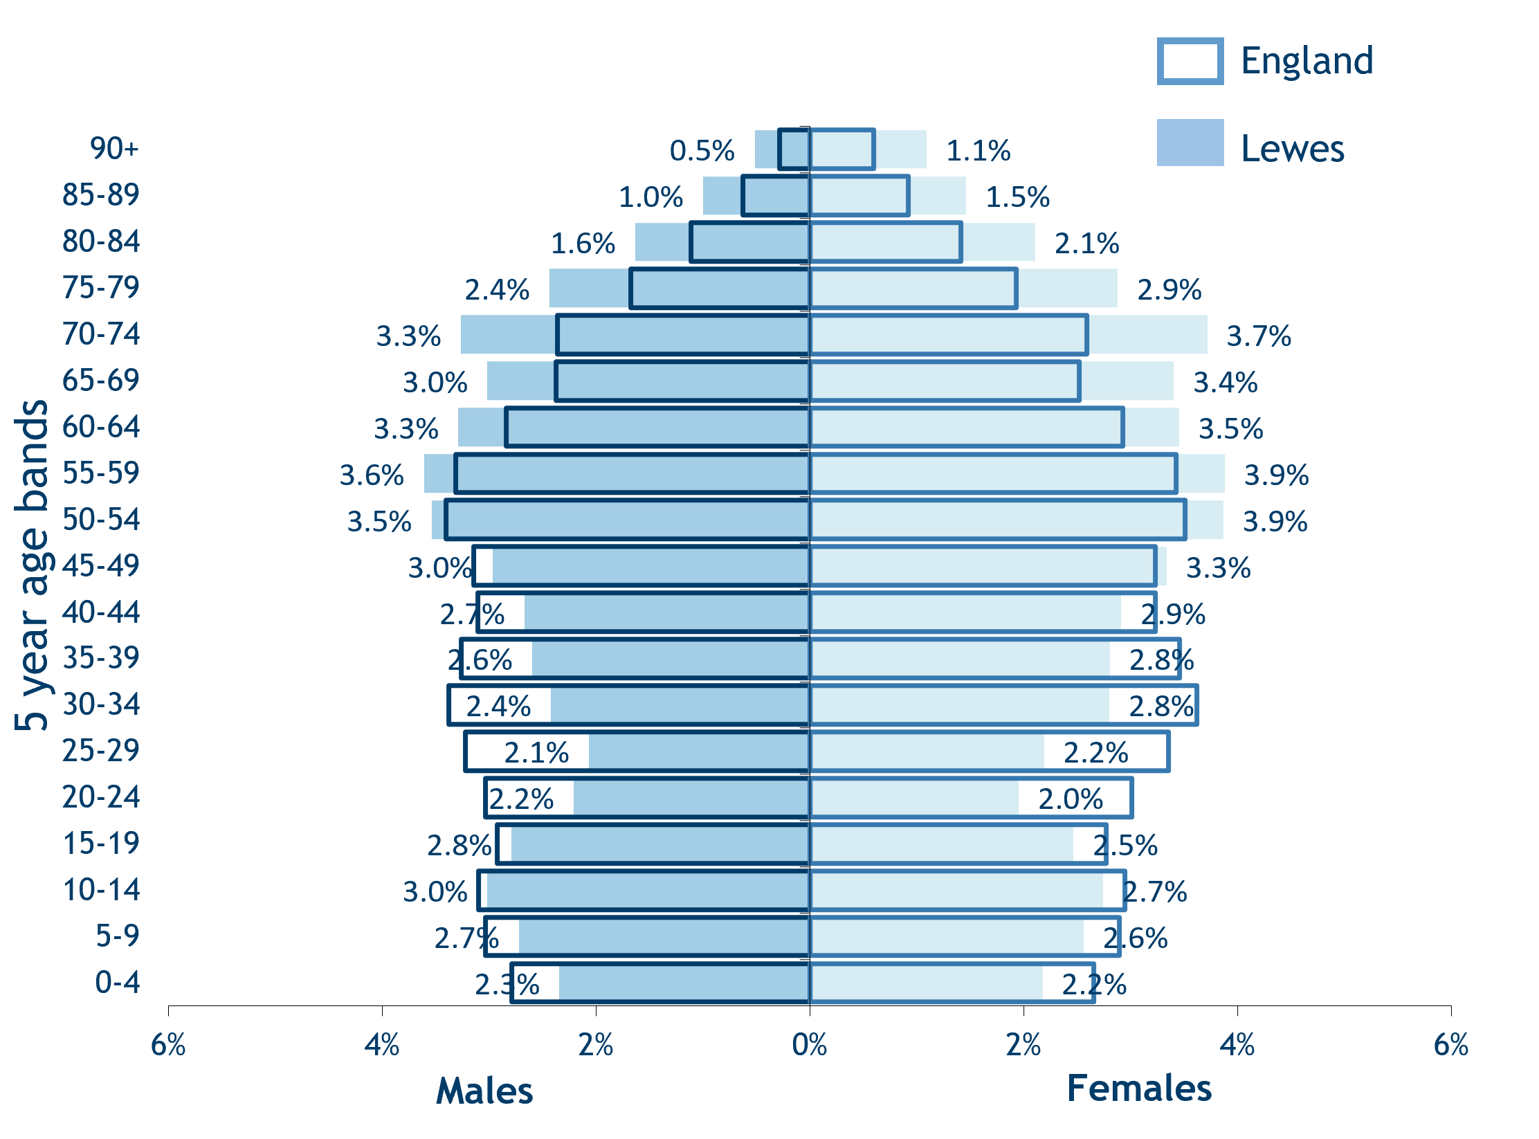
Findings: Lewes Current and Projected Population - Understanding the Age Demographic
Current population and projected future population for the Lewes district.
Lewes population profile in comparison to the UK average
https://www.eastsussexinfigures.org.uk/webview/index.jsp?mode=area&submode=result&areaname=Lewes&areatype=LA
https://www.eastsussexjsna.org.uk/area-profiles/lewes-district-area-profile/
Notes:
Josh C

Slide 8
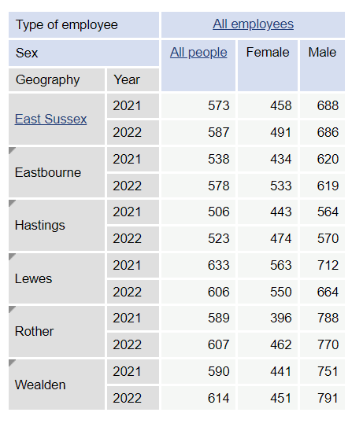
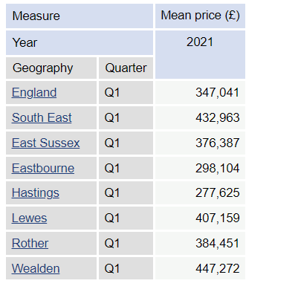
Findings: Key areas of concern for young people: housing prices and cost of living
Average Earnings (per week in £) for residents in East Sussex districts
Average housing prices for East Sussex Districts
https://www.eastsussexinfigures.org.uk/webview/index.jsp?mode=area&submode=result&areaname=Lewes&areatype=LA
https://www.bigissue.com/news/social-justice/young-people-money-citizens-advice/#:~:text=Around%2066%2C000%20young%20people%20approached,private%20rents%20and%20high%20inflation
Notes:
Josh C

Slide 9
Findings: Key areas of concern for young people: Unemployment
Unemployment in East Sussex and Lewes District amongst 16-24 year olds using the 2011 and 2021 census.
https://www.eastsussexinfigures.org.uk/webview/index.jsp?mode=area&submode=result&areaname=Lewes&areatype=LA
Notes:
Josh C

Slide 10
Findings: Competitor Analysis
Many competitors in Lewes, mostly providing advice through:
Linked subheadings to written advice
Telephone support
Youth clubs to encourage engagement and participation
Some competitors:
Lewes Young Adults: community-based group providing activities for improving social and communication skills, building confidence, independence and self-esteem
Sussex Community Development Association - Youth Team: directly addressing young people and services they may need. Youth clubs, mental health services, advice and counselling etc.
Foundry healthcare - services for young persons aged 11-18 and for adults: mental health, wellbeing – social problems
Bank of websites - focusing on money management and debt problems
Bank of websites offering a wide range of services like: exam stress, social media ‘perfection’, high rents, student debt, employment, relationship issues

Slide 11
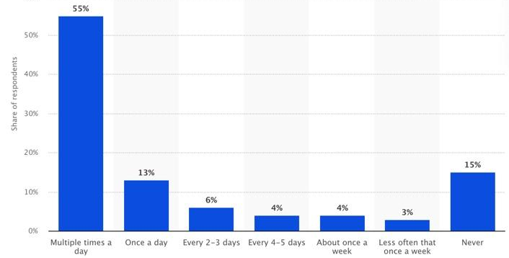
Findings: Social Media
TikTok engagement amongst Gen Z users in the UK
https://www.statista.com/statistics/1365135/tiktok-gen-z-usage-uk-by-frequency/
https://www.statista.com/study/72733/social-media-tiktok-users-in-the-united-kingdom/

Slide 12
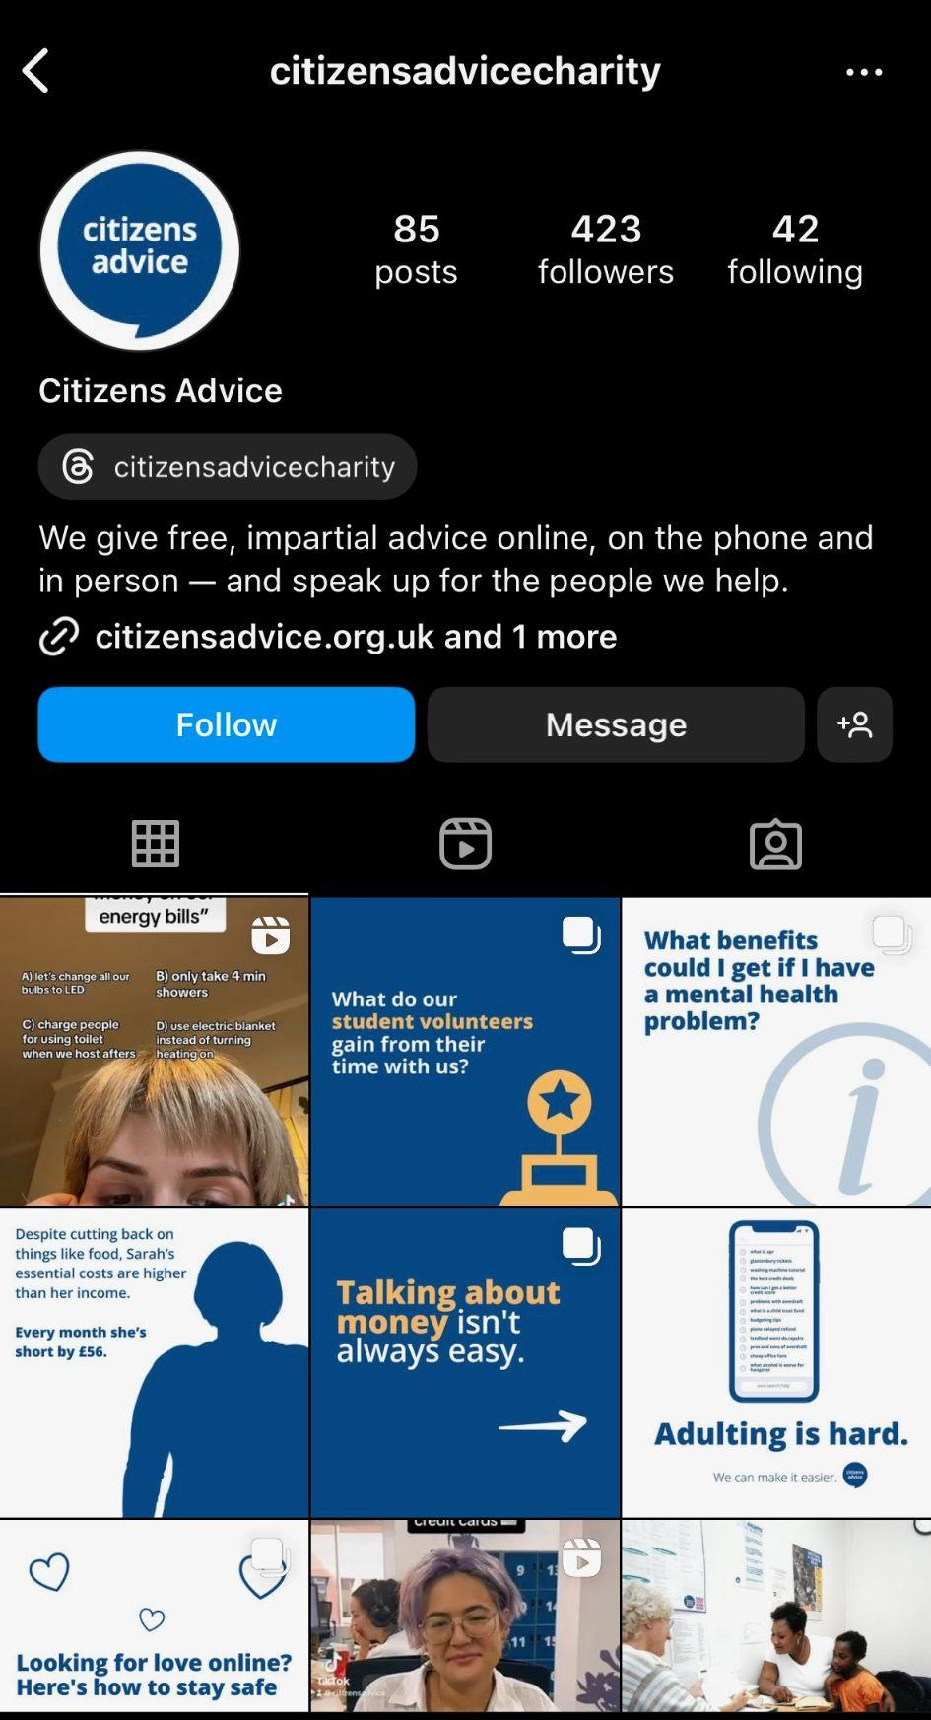
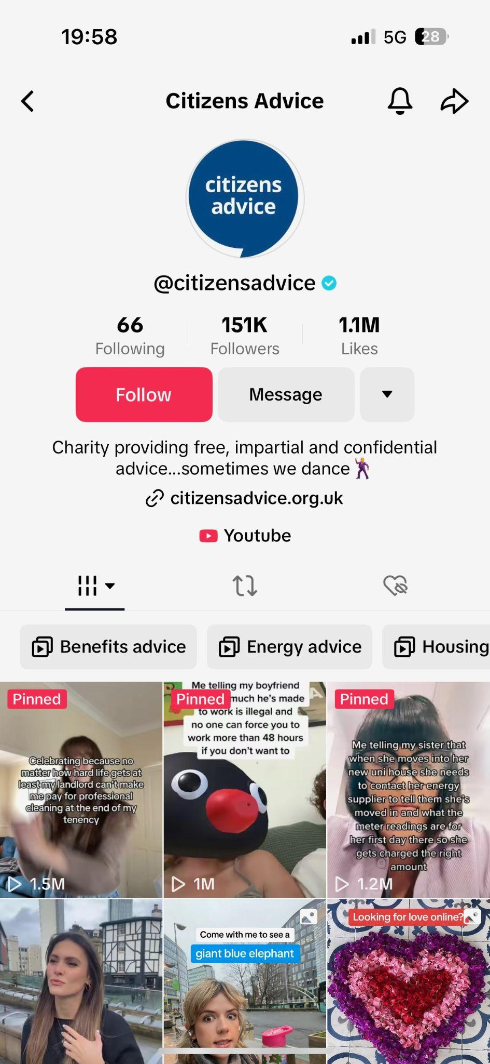
Findings: Market Analysis
Unsuccessful Instagram vs. successful TikTok
TikTok:
Organised content
Substantial following
Trendy, entertaining, cost-effective approach to information dissemination
Instagram:
Low amount of followers
Significantly smaller reach
Much less engaging
https://vm.tiktok.com/ZGeA1FMYf/
Notes:
Their engaging approach to spreading information, leveraging humour and a casual tone, caught my attention. For instance, one video enlightened viewers about the fact that landlords cannot legally compel tenants to pay for professional cleaning at the end of a tenancy – a piece of information that I found useful and entertaining.
What intrigued me even more was the potential to replicate this approach for LDCA's TikTok account, possibly with volunteers, particularly media students, managing the page as part of their work experience. Considering the widespread usage of TikTok as a search engine among young people, it seems like an ideal platform for LDCA to establish a presence.
Leveraging popular audios, hashtags, and keywords, it proved that going viral on TikTok can be achievable with a well-crafted video.
This contrast emphasises the potential of TikTok as a powerful tool for reaching and engaging with a younger audience. The strategy of directing viewers to the LDCA website through the TikTok bio could facilitate further interaction and discussion.

Slide 13
Recommendations:
Youth Engagement Scheme
Partnerships with Educational Institutions, such as Lewes College
Work closely with Wellbeing team
Offer guest talks, workshops, or resource materials that align with academic programs
Host themed workshops, presentations and webinars
Financial literacy, mental health, housing, budgeting, career development, legal rights
Interactive Q&A sessions -> participation
Informational materials available in student resources centres
Notes:
. Aged 16-19, with adult courses
.Financial literacy- Many students are either progressing to university and can learn from general budgeting tips or will need it for the world of work.
.Student Wellbeing team tackle issues such as Mental Health, barriers to learning such as risk of homelessness.
. Currently have a student voice scheme, run by students for students- great opportunity to bridge a gap.

Slide 14
Youth Ambassador Volunteers
A Bespoke Student Representative Scheme
Recruit and train young ambassadors to represent LDCA and connect with peers
Word of mouth
Work experience opportunity
Placements/volunteering within the facility
Helping boost the social media presence
Creating value for the college
Studies from +40,000 consumers from 56 countries find that 88% of consumers trust recommendations from people they know, above all other forms of marketing messaging (Nielsen, 2021). Based off this research, we would also like to introduce a …
Encouraging young people’s engagement with LDAC
Builds trust directly
Promote engagement - social media, marketing experience
Allow for young people to have work experience (volunteering) on their CVs through being active student reps for LDCA, also engaging in the creation of social media content - a fun campaign to directly involve young individuals
Help with the reduction of unemployment rates in the long term, a mutual relationship
‘Engagement for Experience’

Slide 15
Tailored Outreach Campaigns through Social Media Content
Promote media content by engaging Student Representatives in content creation!
Design targeted marketing campaigns addressing directly the concerns and interests of the 16-25 age group
Highlight specific issues and emphasise how LDCA can provide support
Leverage social media platforms to share information, tips, and advice
Instagram, TikTok, Snapchat
Create engaging content
Short videos, infographics, and interactive posts
Create video series addressing common issues faced by young adults
Feature real stories, interviews with experts, and practical advice in an easily consumable format

Slide 16
TikTok Video Ideas
#LifeHacks
Humorous Legal Situations
Interactive Polls
DIY Workshops
Trend Challenges with a Twist
Scenario Challenges
Legal Lingo Breakdown
Mythbusters
Quick Tips Series
Behind-the-scenes
Interactive Q&A
Mini Educational Series
Testimonials

Slide 17
Thank You!

Slide 18
References
https://www.citizensadvice.org.uk/resources-and-tools/search-navigation-tools/Search/?q=young+people&c=TOP-PUBLIC
https://www.bigissue.com/news/social-justice/young-people-money-citizens-advice/#:~:text=Around%2066%2C000%20young%20people%20approached,private%20rents%20and%20high%20inflation.
https://www.eastsussexjsna.org.uk/area-profiles/lewes-district-area-profile/
https://www.eastsussexinfigures.org.uk/webview/index.jsp?mode=area&submode=result&areaname=Lewes&areatype=LA
https://www.aspens.org.uk/childrens-services-in-east-sussex
https://sussexcommunity.org.uk/our-services/youngpeople/
https://learning4lifesussex.org.uk/living/community-organisations/youth-work
https://www.foundryhealthcarelewes.co.uk/mental-health-and-wellbeing/
https://www.lewes-eastbourne.gov.uk/article/1382/Help-with-money-and-debt
https://learning4lifesussex.org.uk/living/community-organisations/youth-work
https://www.statista.com/statistics/1365135/tiktok-gen-z-usage-uk-by-frequency/
https://www.statista.com/study/72733/social-media-tiktok-users-in-the-united-kingdom/
https://sussexlaw.clinic/clinic/citizens-advice-project/#:~:text=If%20you%20are%20a%20current,to%20continue%20volunteering%20year%2Dround
https://www.nielsen.com/wp-content/uploads/sites/2/2021/11/2021-Nielsen-Trust-In-Advertising-Sell-Sheet.pdf

